Slide 1
"Secure Data Hiding in Images Using Steganography"
CAPSTONE PROJECT
Presented By: Yashwanth thandu
Student Name : Yashwanth thandu
College Name : Sri Sai triveni college
Department : BCOM (CA)

Slide 2
OUTLINE
Problem Statement
Technology used
Wow factor
End users
Result
Conclusion
Git-hub Link
Future scope

Slide 3
Problem Statement
In today's digital age, securing sensitive data is of paramount importance. Traditional encryption methods focus on securing the data itself, but they often draw attention to the fact that sensitive information is being transmitted or stored. Steganography, the practice of hiding information within another medium such as images, offers a potential solution to this challenge by concealing the existence of the hidden data, ensuring that unauthorized parties remain unaware of the presence of sensitive content.

Slide 4
Technology used
Libraries : CV2
Platforms : Python
RAM : 8GB
Windows : 11 Home

Slide 5
Wow factors
In a world where data breaches and privacy invasions are increasingly common, traditional encryption methods, while effective, expose the very existence of sensitive information. Imagine a world where your confidential data isn't just encrypted, but is completely invisible to prying eyes—hidden in plain sight within seemingly innocent images. Steganography, the art of embedding secret data within digital images, takes security to an entirely new level by not only protecting the content but also concealing the presence of the data itself. This ensures that your sensitive information goes unnoticed, even when intercepted. In essence, it’s a digital stealth mode for your most valuable data, making it undetectable and untraceable, providing an unparalleled layer of protection in an age of constant cyber threats.

Slide 6
End users
1) Government and Intelligence Agencies
2) Cybersecurity Professionals
3) Businesses and Corporations
4) Journalists and Whistleblowers
5) Military Personnel
6) Legal Professionals
7) Academics and Researchers
8) Cryptographers
9) Consumers (Personal Use)
10) Social Activists and Human Rights Organizations

Slide 7
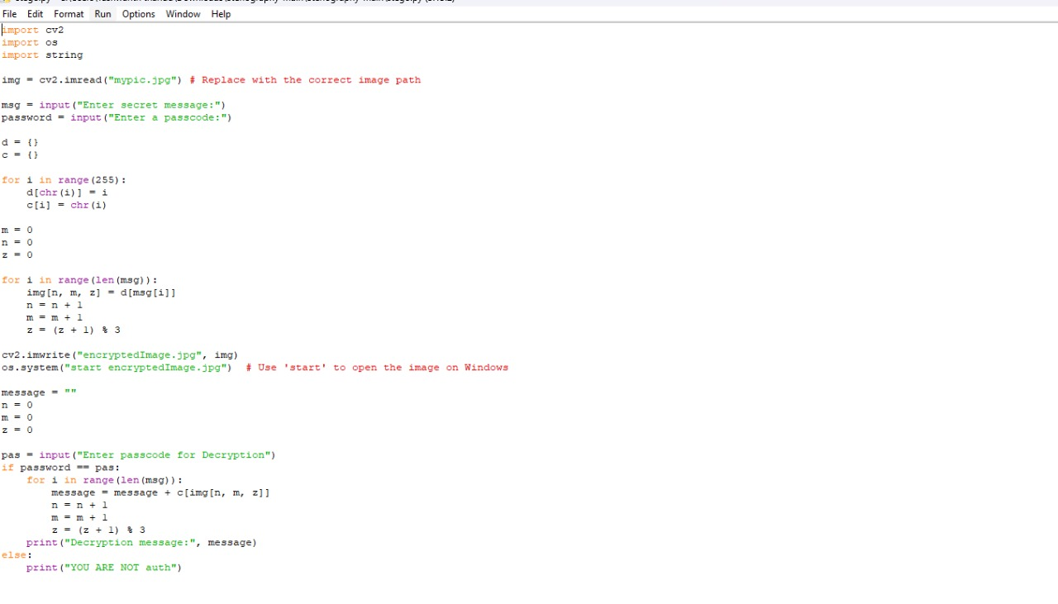
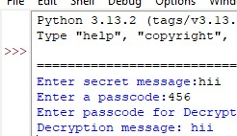

Results

Slide 8
Conclusion
Secure Data Hiding in Images Using Steganography presents a powerful and innovative solution to the growing challenge of protecting sensitive information in the digital world. By embedding confidential data within innocent-looking images, steganography provides an added layer of security that traditional encryption techniques often fail to offer—namely, the invisibility of the hidden data. This method not only ensures the confidentiality of the information but also makes it undetectable to unauthorized parties, offering a significant advantage in secure communication and data storage.

Slide 9
GitHub Link
https://github.com/yashthandu3/project-.git

Slide 10
Future scope(optional)
The future of Secure Data Hiding in Images Using Steganography holds immense promise across various domains. The continual evolution of technology will drive new innovations, making steganography a vital tool for ensuring privacy and security in an increasingly connected world. Through advanced encryption, machine learning, and multimedia applications, the scope for steganography will expand, allowing for more secure and stealthy data protection mechanisms in diverse real-world scenarios.

Slide 11
THANK YOU

